Slide 1
Energy-based Out of Distribution Detection for Graph Neural Networks
Presenter: Jiaqing Xie
2024.06.07

Slide 2
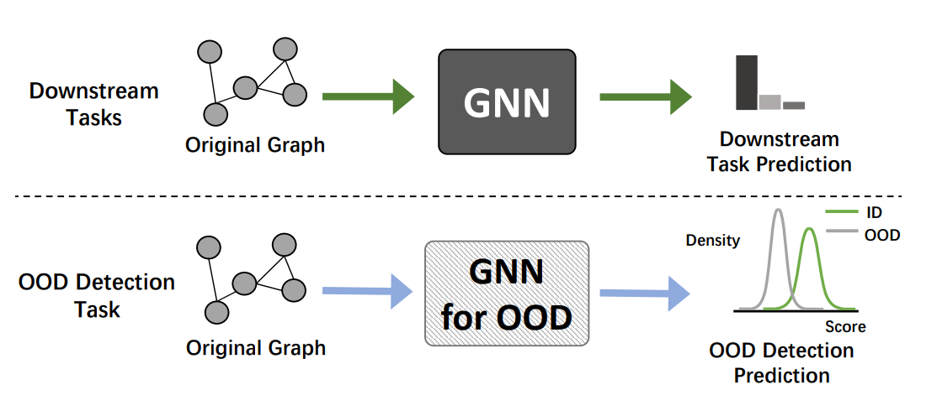
Traditional Graph Learning vs. Graph OOD Detection
V: Vertexes, E: Edges, A: Adjacency Matrix
Graph G = (V, E, X), X: node features
Graph Neural Network F(A, X)
Traditional Graph Learning
Task: Node / Graph Classification, …
Graph OOD Detection
Task: Binary Classification

Slide 3

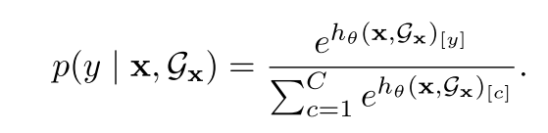
A GNN Baseline (Example: GCN)
Layer-wise Propagation
(dim = C)
GNN Classifier (softmax)

Slide 4
Limitation of Softmax for OOD Detection
In Image Domain, directly use the predictions of CNNs for OOD detection would lead to overconfidence of OOD data [Nguyen et al. ].
In Graph Domain, this overconfidence also exists for Graph OOD data [Wu et al. ].
Motivation : Use of Energy function, which is proved to be aligned with probability density of input data [Liu et al.].
Deep Neural Networks are easily fooled. Nguyen et al. CVPR 2015
Energy-based Out of Distribution Detection. Liu et al. NeurIPS 2020
Energy-based Out of Distribution Detection for Graph Neural Networks. Wu et al. ICLR 2023

Slide 5


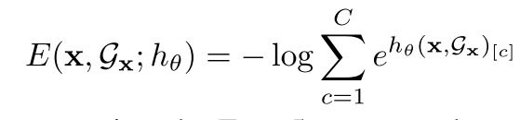
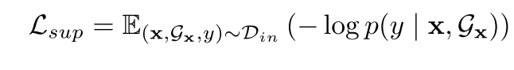
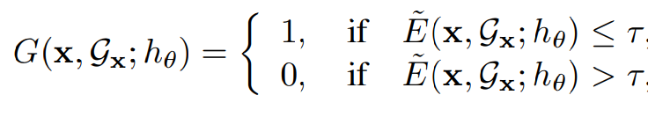
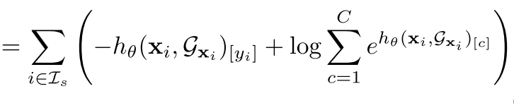
Motivation 1: Use of Energy
Original Predictor
Energy
Free energy function
Loss Objective (Original Predictor)
OOD Predictor

Slide 6
Motivation 2: Label Propagation
Not all graph data are labeled
Graph data are inter-dependent, propagation with energy reinforces the confidence on detection
Label Propagation, a non-parametric semi-supervised learning algorithm

Slide 7


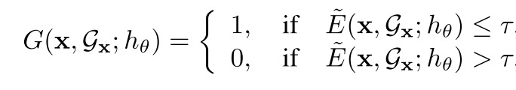
Label Propagation
Recall
Initialize Energy
Belief Propagation
OOD Detector

Slide 8


Motivation 3: Regularization
Previous settings didn’t include training Graph OOD data.
Energy range: [t_in, t_out]
Loss Objective
In distribution
Out-of distribution

Slide 9
Experiments
Baselines:
MSP
ODIN
Mahalanobis
OE (Outlier Exposure)
Energy
Energy without energy propagation
GKDE
GPN

Slide 10
Experiments
Graph OOD data creation follow two settings: multi-graph and single graph
Multi-graph
Choose subgraph DE as IID, other 5 subgraphs as OOD [Twitch]
Single graph
Change structures / features / labels [Cora, Amazon, Coauthor]
Partition nodes (Arxiv), before 2015 IID, after 2017 OOD

Slide 11
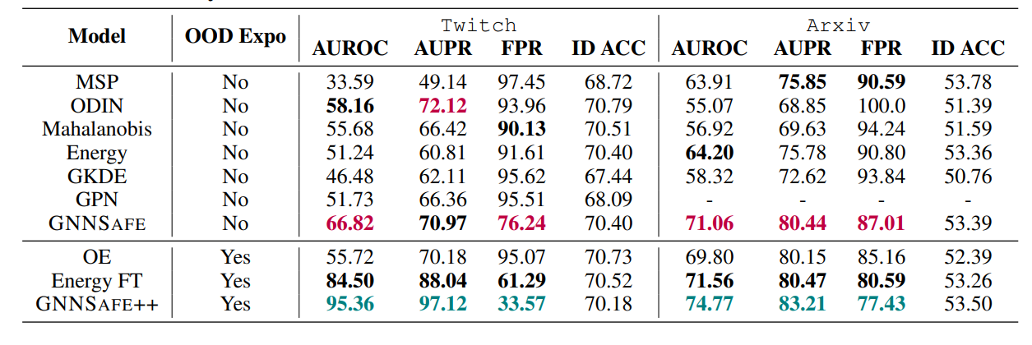
Results 1
Metrics: AUROC, AUPR, FPR95

Slide 12
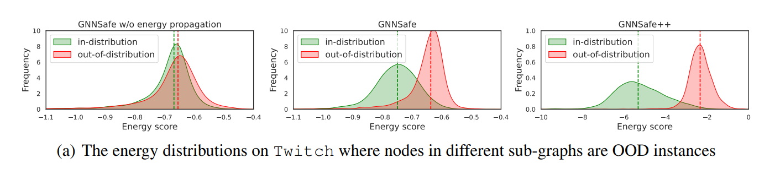
Results 2

Slide 13
Thanks

Slide 14
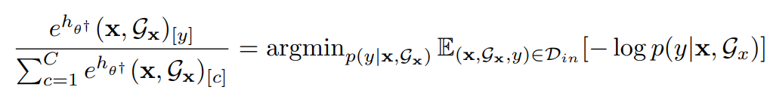
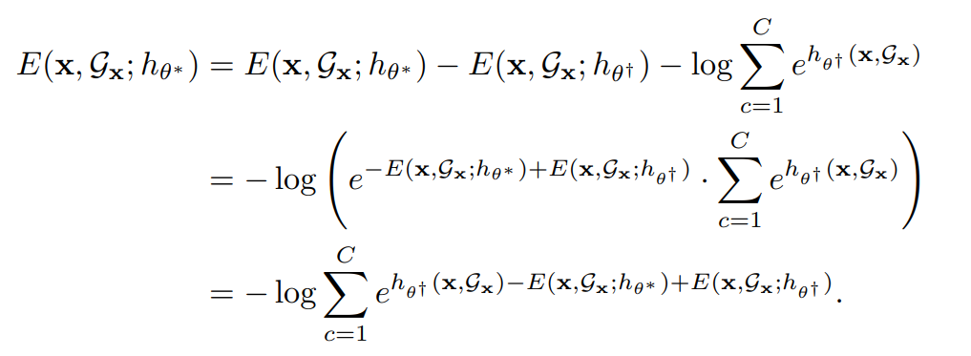
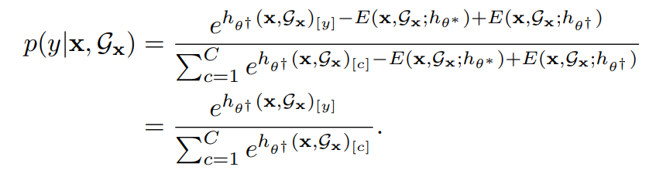
Motivation 3: Regularization
Additional regularization doesn’t effect NLL
Proof:

